Slide 1


Understanding Intelligence Gathering Disciplines
Intelligence gathering is key for informed decisions across sectors. It involves collecting secret or confidential data systematically. This presentation explores core disciplines, methods, and real-world applications shaping strategic actions in security, business, and investigations.
by rayed

Slide 2
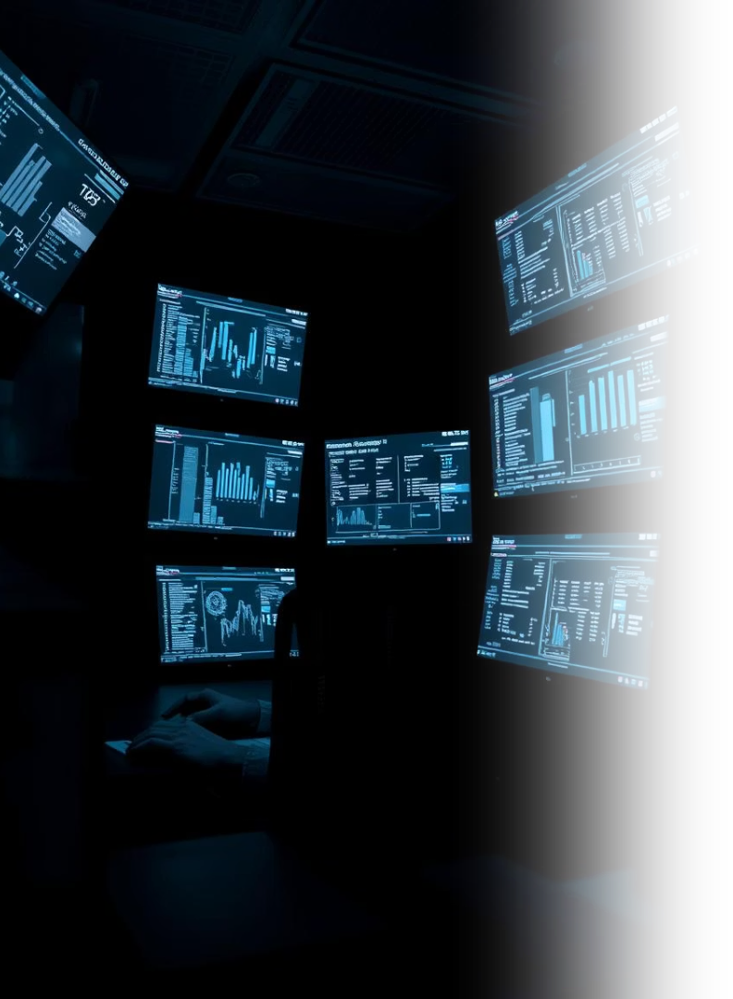
What Are Intelligence Gathering Disciplines?
Definition
Purpose
Structured methods to collect non-public data for decision-making.
Support strategic planning, policy, and threat assessment.
Characteristics
Focused on specific info types and often combined for full insight.

Slide 3
Core Intelligence Categories
HUMINT
SIGINT
IMINT & GEOINT
Information from human sources.
Electronic signals and communications.
Imagery and geospatial data analysis.

Slide 4
Additional Intelligence Disciplines
MASINT
OSINT
CYBINT
Physical and signature analysis of targets.
Publicly available information.
Cyber domain threats and activities.

Slide 5

Specialized Disciplines
FININT
TECHINT
Financial data to detect illicit activities.
Analysis of adversary technology and weapons.
CI & EI
Competitive and economic intelligence for strategic advantage.

Slide 6



Human Intelligence (HUMINT)
Techniques
Interviews
Espionage
Interrogations
Focus
Intentions, opinions, and insider knowledge.

Slide 7

Signals Intelligence (SIGINT)
FISINT
ELINT
Telemetry from foreign weapons systems.
COMINT
Non-communication electronic signals.
Intercepted communications.

Slide 8


Imagery & Geospatial Intelligence
IMINT
GEOINT
1
2
Visual data from satellites and drones.
Geographic and imagery integration.

Slide 9

Real-World Applications
Cold War HUMINT
SIGINT in WWII
Oleg Penkovsky’s Soviet military insights.
Decoding German communications.
OSINT & CYBINT Today
Tracking cyber threats and global events.

